Slide 1

Spatial and storm-time dependence of electron microburst pitch angle isotropy
Presented by Conrad Meyer-Reed

Slide 2
Outline:
Introduction
Mission Background
Statistical Year Study
Storm-time Epoch Analysis
Conclusions

Slide 3
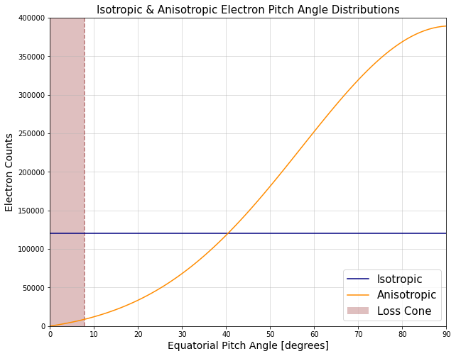
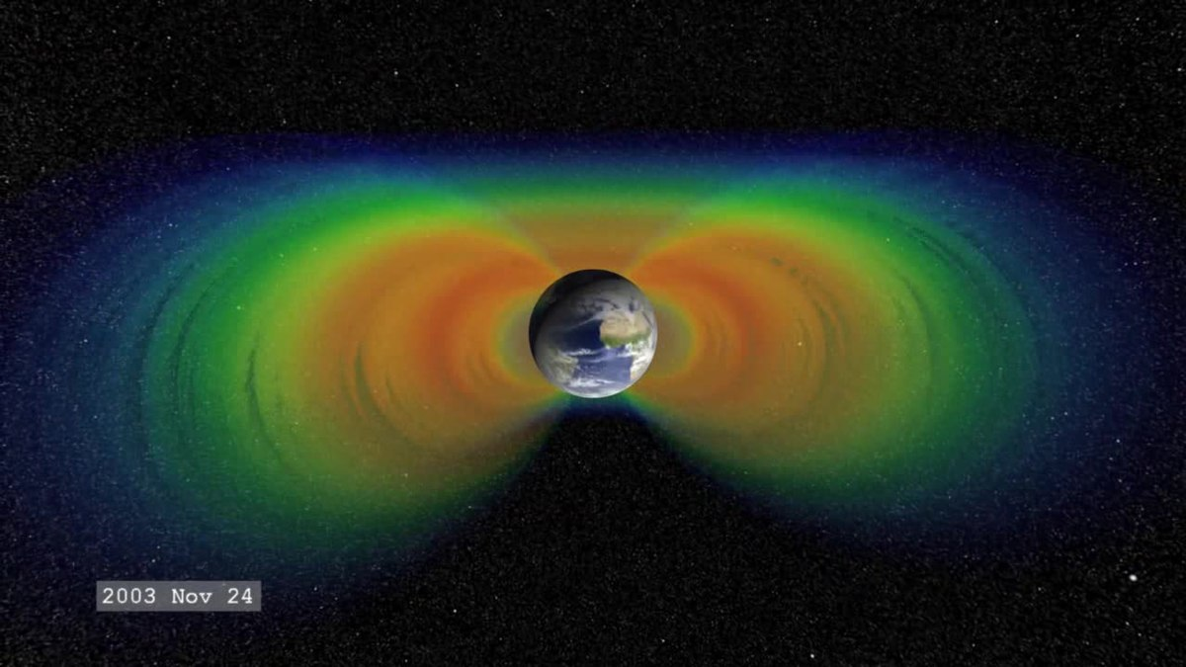
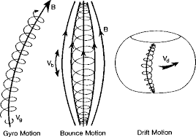
Introduction
The Earth’s radiation belts are composed of electrons interacting with the planetary magnetic field in 3 main motions:
Gyro motion (~1 ms)
Bounce motion (~0.1-1.0 s)
Drift motion (~1-10 min)
Electrons with small velocity pitch angles will more likely precipitate into the atmosphere before bouncing
Pitch angle isotropy is defined by how electron population velocity pitch angles are distributed:
Isotropic: Pitch angles are pointed everywhere equally
Anisotropic: Pitch angles are pointed unevenly
J. Sample, PhD Thesis (2013)
(From Yuting Ng, 2013)
(From Wikipedia)

Slide 4
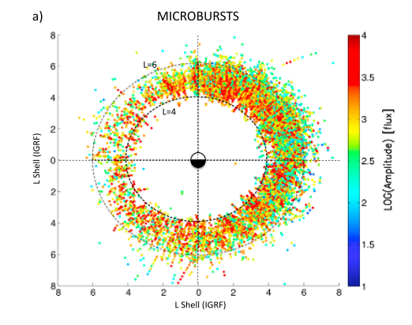

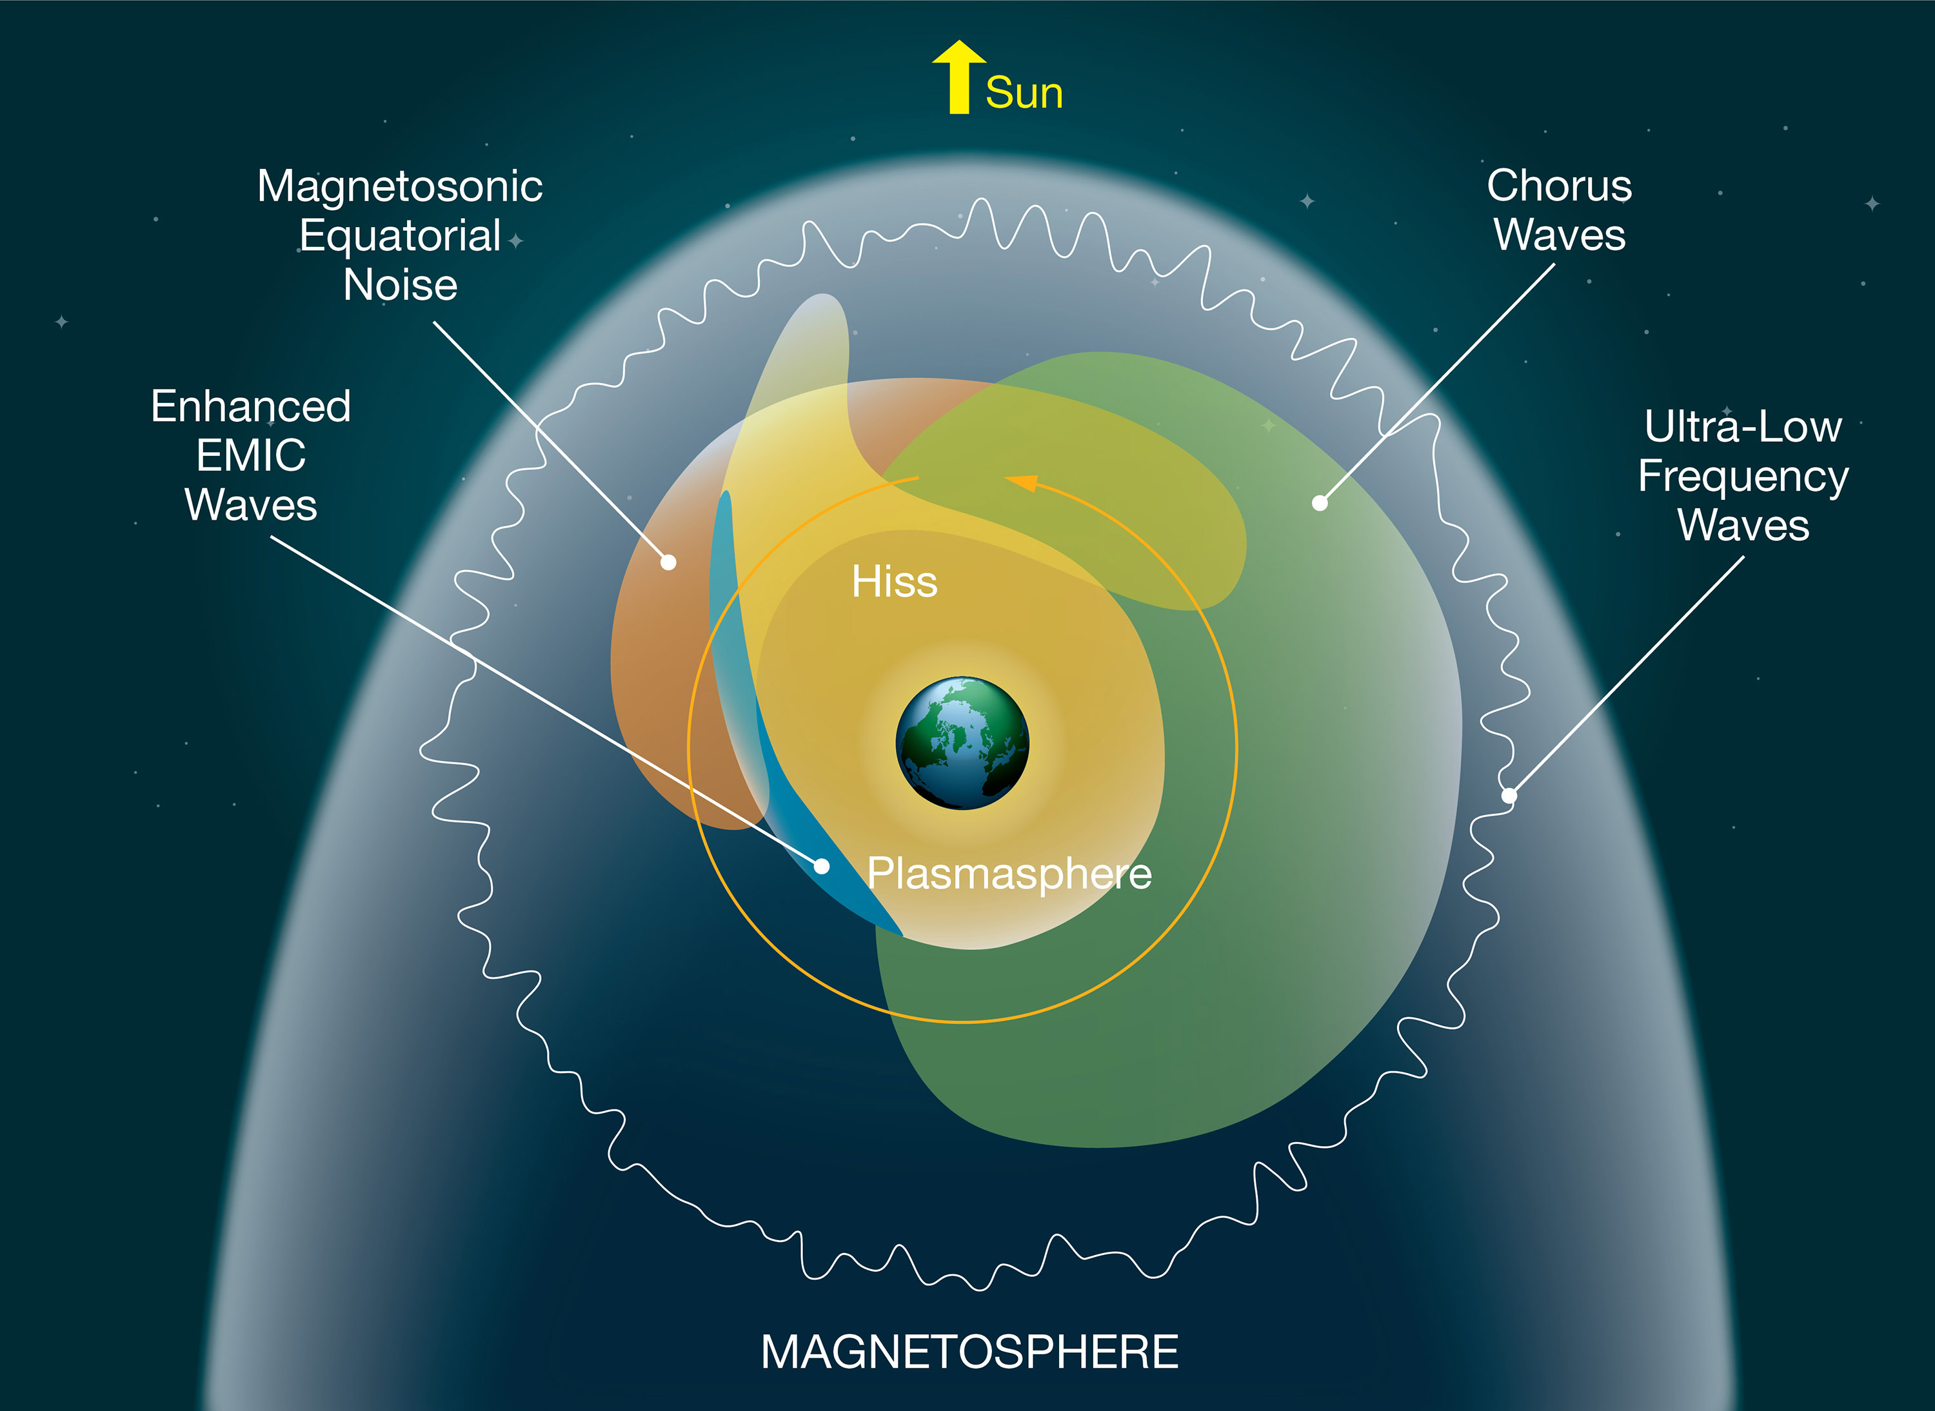
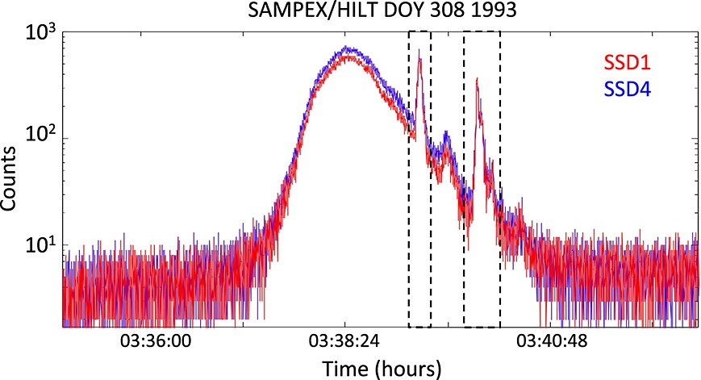
Introduction
Microbursts:
Sub-second bursts of pitch angle isotropic MeV-energy electrons
Microbursts have been previously associated with chorus wave activity
Most frequent in the morning magnetic local time region
Microburst detection algorithm:
(From Blum et al, 2015)
(From Blum et al, 2015)
(From NASA)

Slide 5
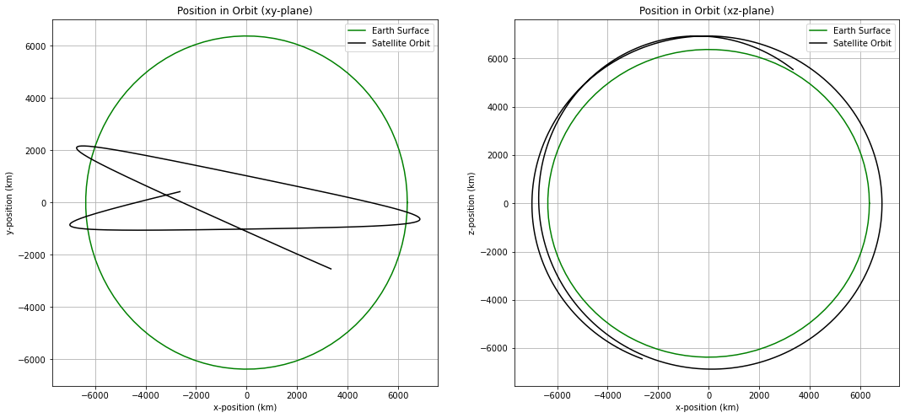
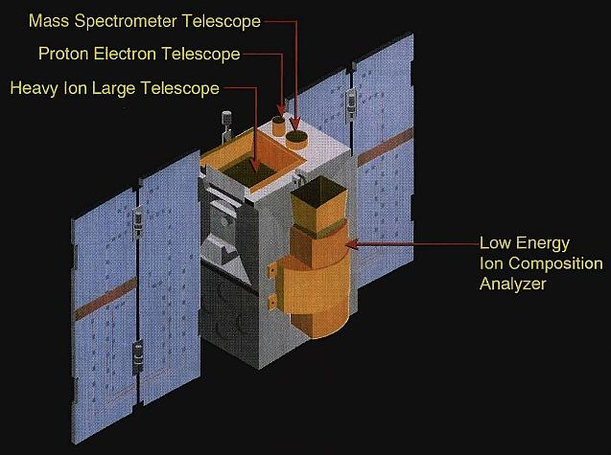
Mission Background
The Solar Anomalous and Magnetospheric Particle Explorer (SAMPEX) satellite collected information about particles in the Earth’s radiation belts in near polar orbit from 1992-2004
SAMPEX was the first spacecraft in the NASA Small Explorer program
The Heavy Ion Large Telescope (HILT) instrument onboard the SAMPEX satellite consisted of 4x4 Silicon detector array that recorded >1 MeV electron counts in high latitude regions of the magnetosphere
(From eoPortal Directory)

Slide 6
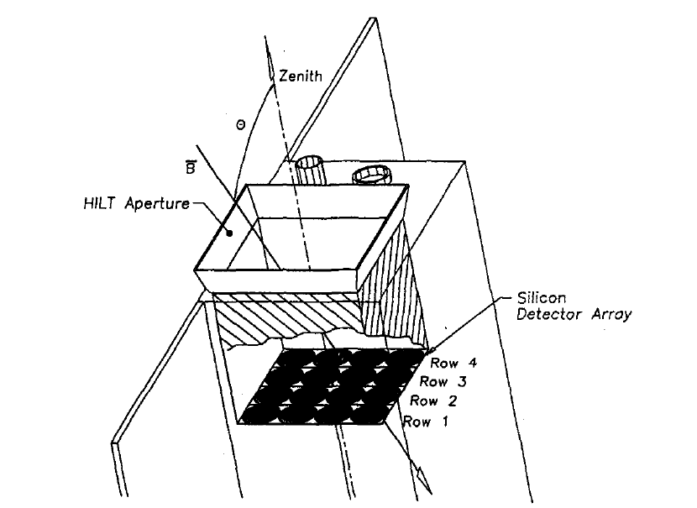
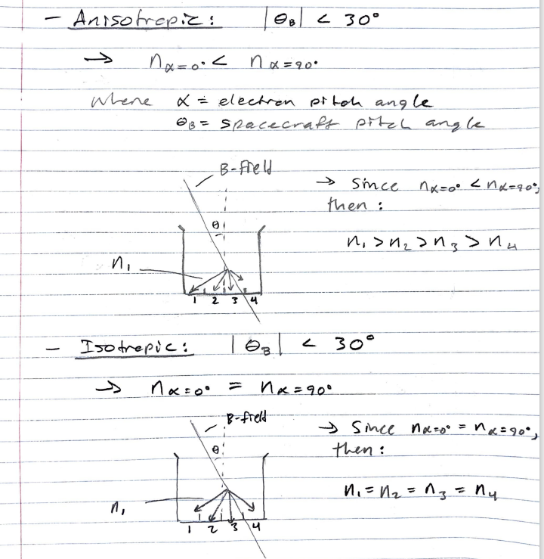

Mission Background
When anisotropic populations of electrons are collected by the HILT instrument, the geometry of the detector rows will cause differences in the total electron counts detected across the array.
Conversely when isotropic populations of electrons are collected by the HILT instrument, the total electron counts detected will be similar across the array.
(From Blake et al, 1996)
By taking the ratio of electron counts from Row 1 (SSD1) and Row 4 (SSD4) of the detectors, a measure of pitch angle isotropy can be determined, where:
Iso = 0 -> Anisotropic
Iso = 1 -> Isotropic
Isotropy Index Calculation:

Slide 7
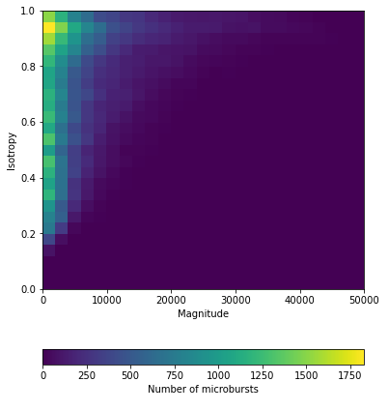

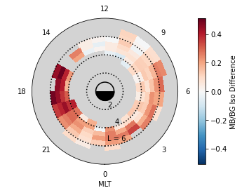
Statistical Year Study
Methods:
SAMPEX electron counts data selected from the year 1993
Analysis of correlations between isotropy index, microburst magnitude, and spatial parameters
Microburst magnitude calculation:
Results:
Trend in data shows a positive correlation between microburst isotropy index and microburst magnitude
Low magnitude: 0.2 – 1.0 isotropy index
High magnitude: ~1.0 isotropy index
Median isotropy dial plot indicates high isotropy difference in the evening MLT range, medium isotropy in the midnight-morning MLT range, and low isotropy in the noon MLT range

Slide 8
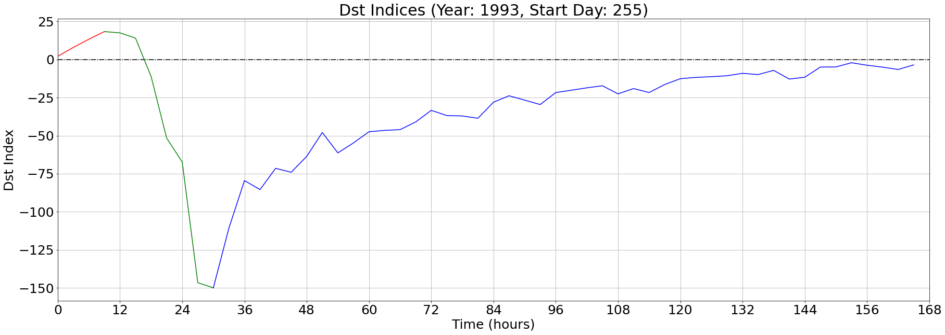
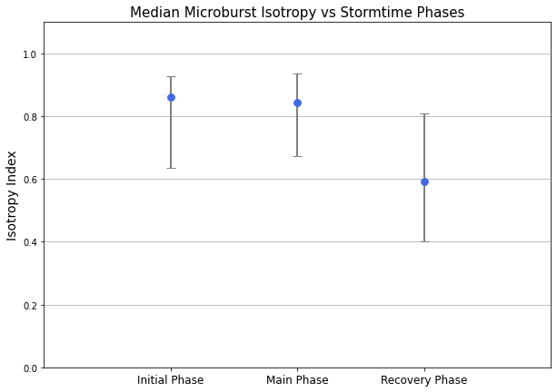
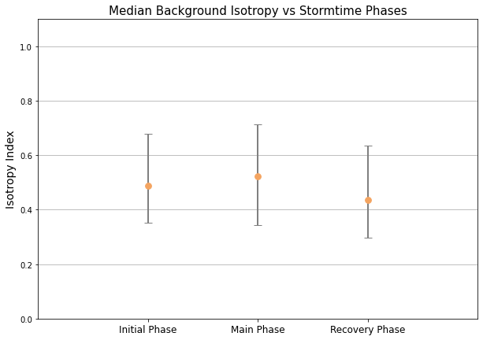
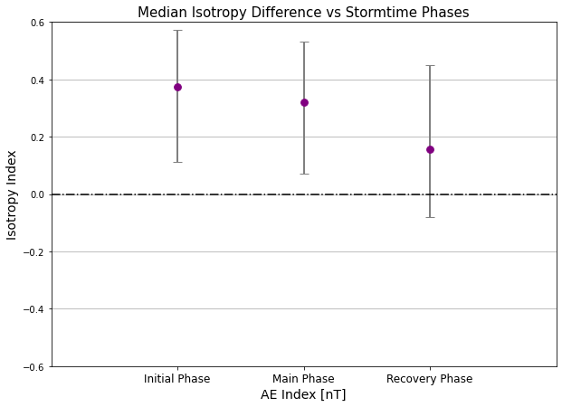
Storm-time Epoch Analysis
Methods:
Out of the 9 geomagnetic storms from 1993 with Dst_min < 100 nT, 6 storms with typical Dst profiles were selected for our analysis
Analysis of storm-time dependence of median microburst isotropy for initial, main, and recovery phases of the 6 geomagnetic storms
Results:
Negative trend in median isotropy difference can be seen as storm phases progress

Slide 9
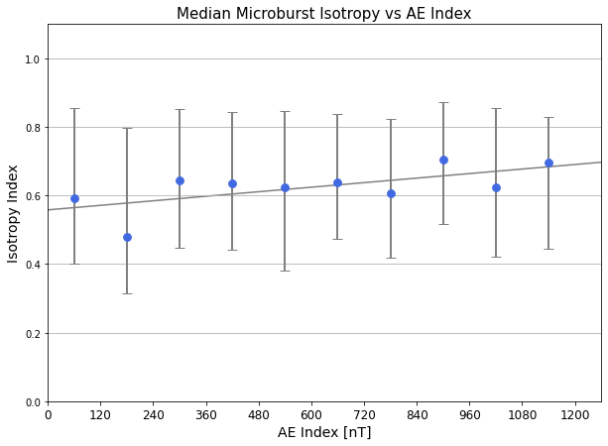
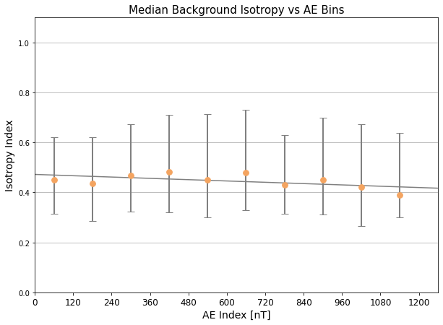
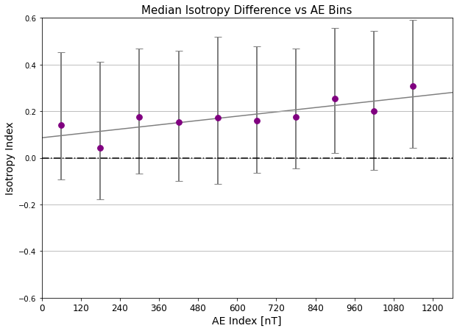
Storm-time Epoch Analysis
Methods:
Out of the 9 geomagnetic storms from 1993 with Dst_min < 100 nT, 6 storms with typical Dst profiles were selected for our analysis
Analysis of median microburst isotropy vs binned AE indices
Results:
Positive trend in median isotropy difference can be seen as AE indices increase in magnetic field strength

Slide 10
Conclusions
[finish slide]
[talk about implications of high microburst isotropy in evening MLT region (EMIC?)]
[setup for future research]

Slide 11
Acknowledgements

Slide 12
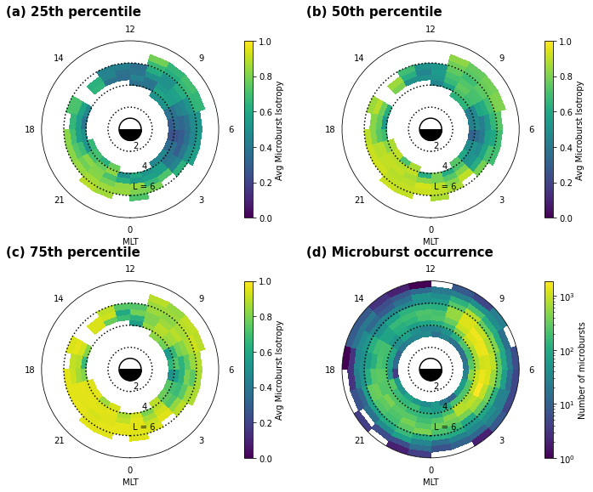
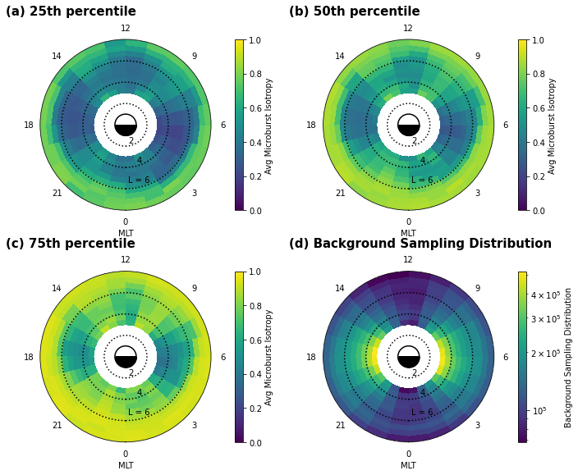
Extra Info Slide

